Slide 1
The Ephys Pipeline
a closer look to the workflow and ingestion routine

Slide 2
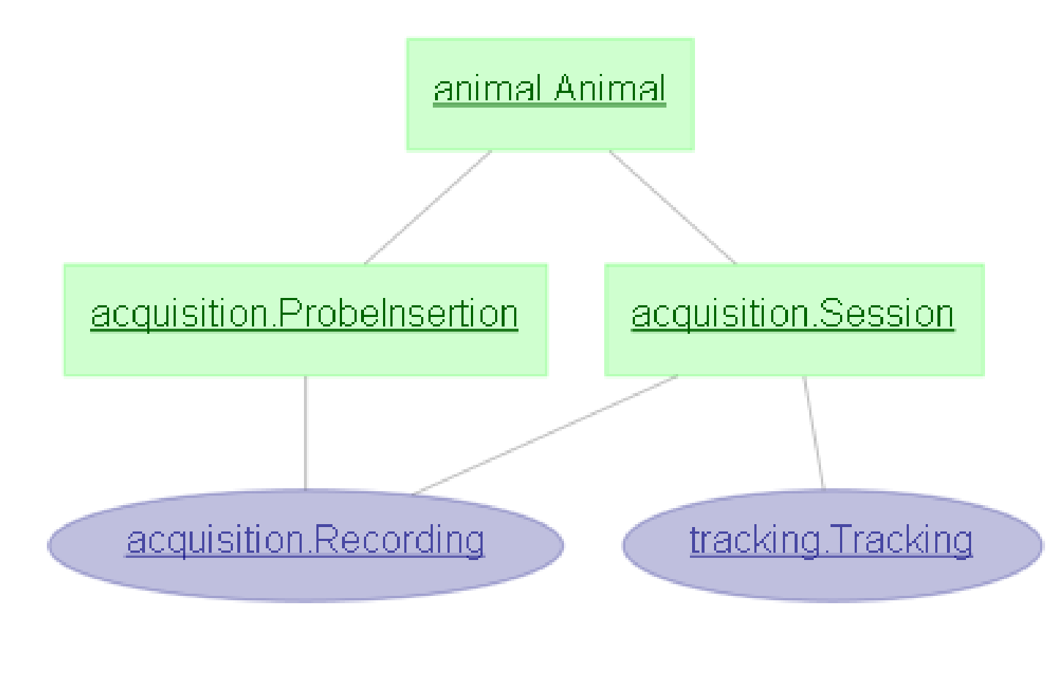
Recap – Session Structure

Slide 3
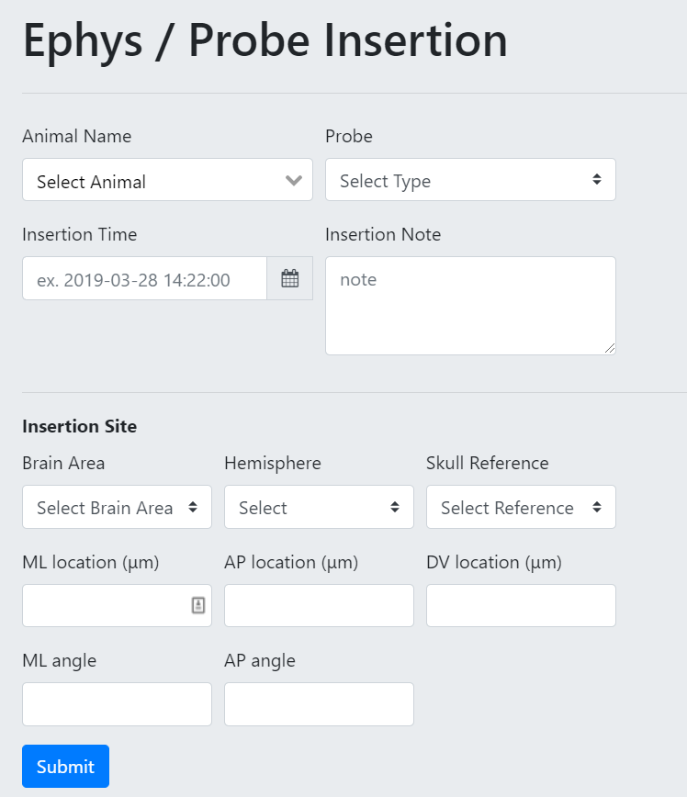
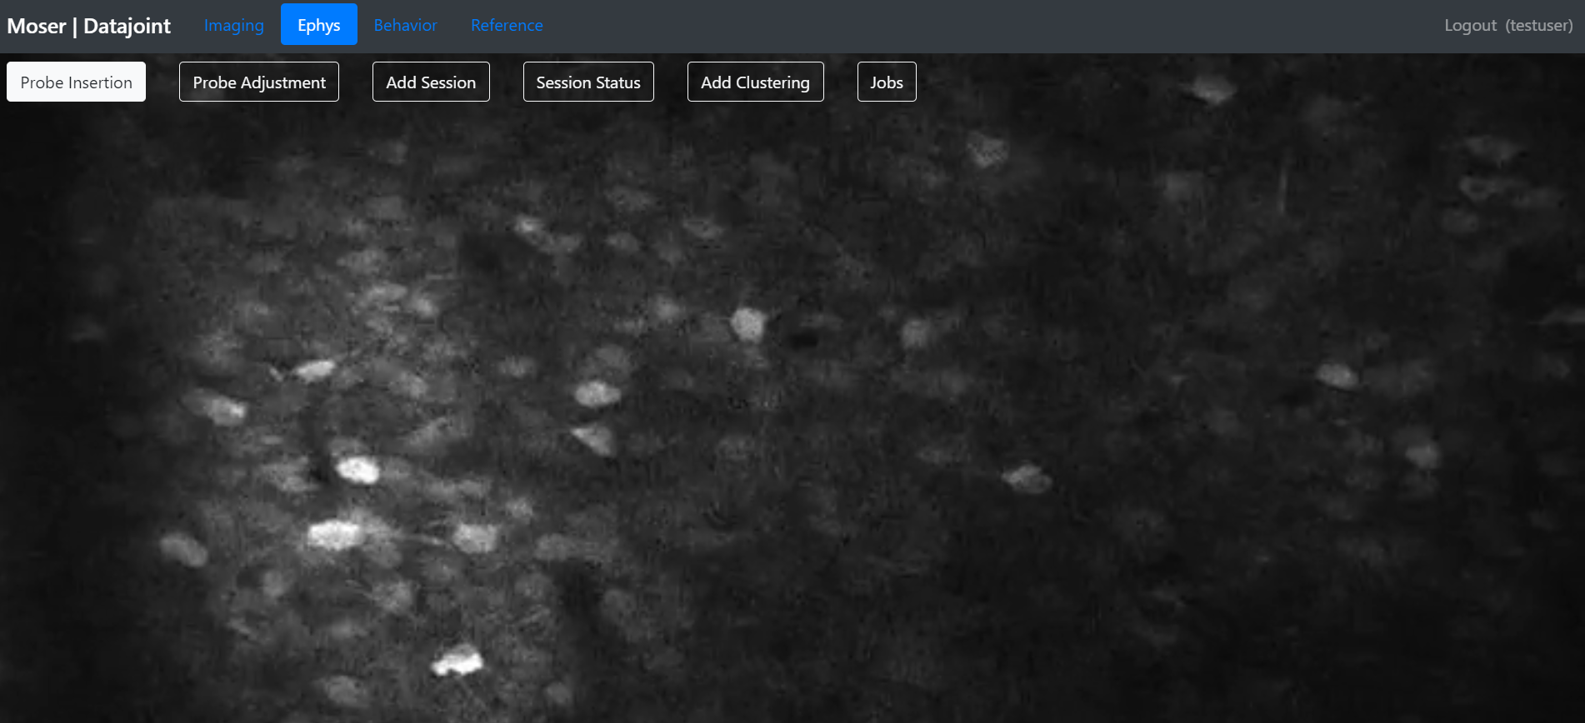
Probe Insertion

Slide 4
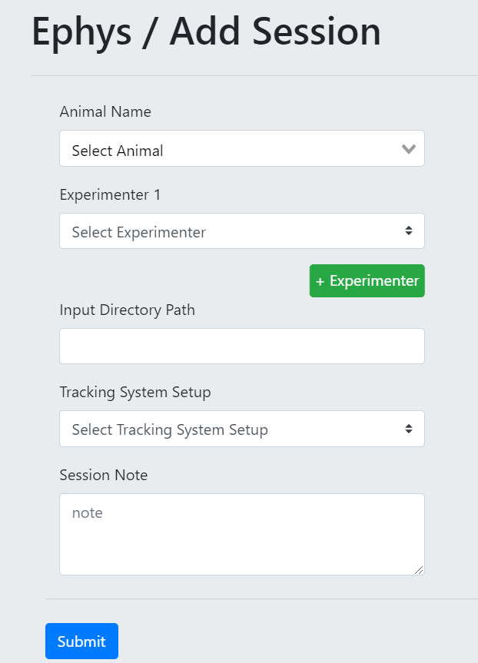
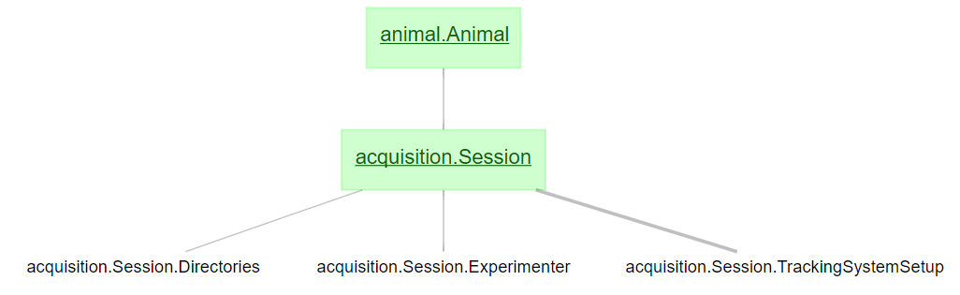
Insert a session

Slide 5
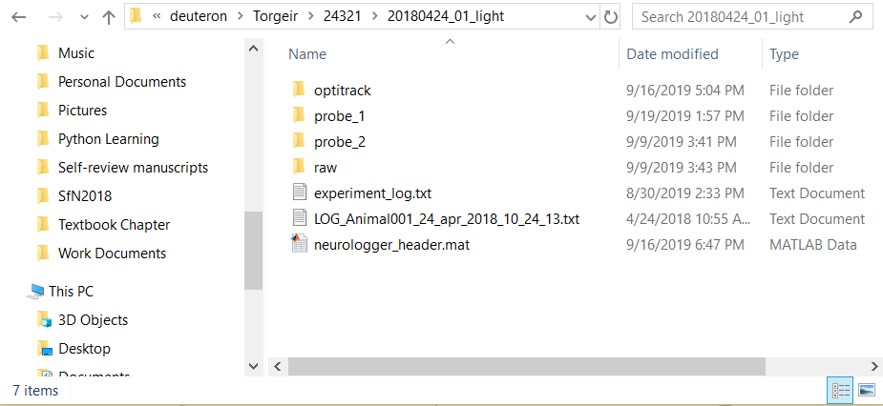
A Demo with dj-GUI
A multi-probe neurologger session
Animal: 24321
/mnt/N/sampledata/deuteron/Torgeir/24321/20180424_01_light

Slide 6
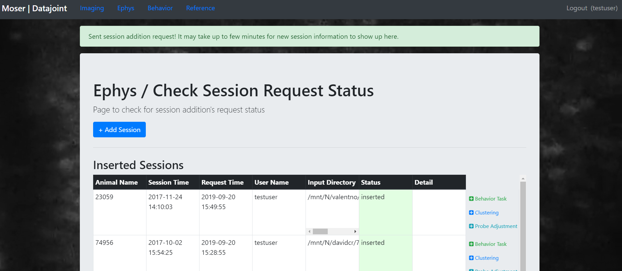
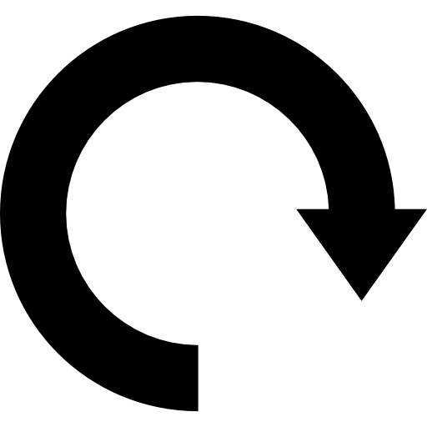

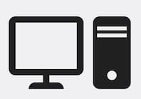
Under the hood
dj-GUI
Session Request
Process Request
Find the specified input directory
Identify:
Recording(s)
Recording type
Probe folder(s)
Session Insert
Check for inserted probes for the specified animal
Request more info
Update status
Workers

Slide 7
Under the hood
dj-GUI
Session Request
Find the specified input directory
Session Insert
Identify:
Recording(s)
Recording type
Probe folder(s)
Animal
Session Time
Check for inserted probes for the specified animal
Data Directory
Experimenter
Request more info
Update status
Probe Association

Slide 8
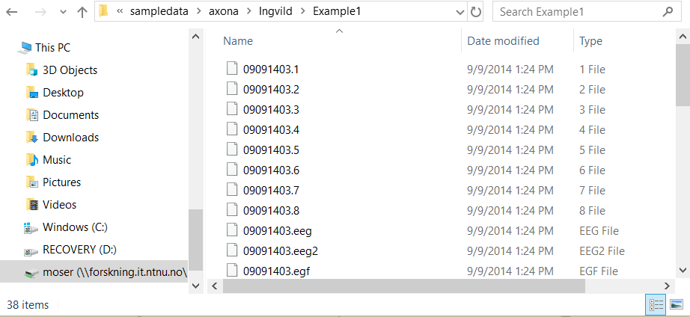
A Demo with dj-GUI
A multi tetrode-array session
Animal: 88068
/mnt/N/sampledata/axona/Ingvild/Example1

Slide 9
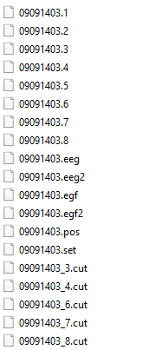
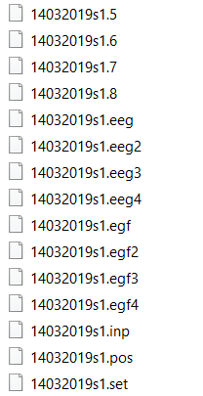
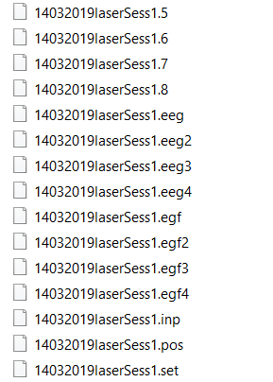
Ingestion of Recording and Tracking - AXONA
Axona session input directory
Axona session are identified by .set files
Multiple recordings – multiple ‘.set’
…/axona/14032019/
…/axona/09091403/
Tetrode(s) are identified by .number files
Tracking data identified by .pos file
Multiple probes?
Can be inferred based on the information in Probe Associations inserted with Session

Slide 10
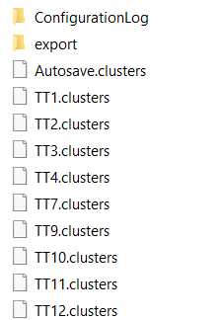
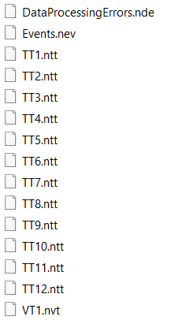
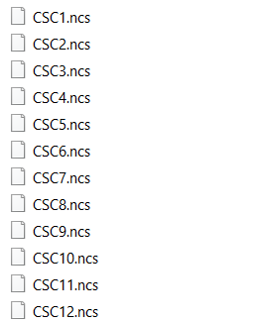
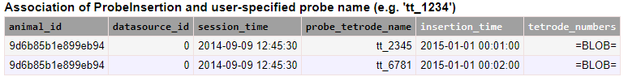
Ingestion of Recording and Tracking - Neuralynx
Neuralynx session indicated by the .ncs files
One recording per session
Tracking identified by the .nvt file
Tetrode(s) identified by .ncs files
Multiple probes?
Can be inferred based on the information in Probe Associations inserted with Session
acquisition.Session.TetrodeProbeAssociation & key
[1, 2, 3, 4]
[5, 6, 7, 8]

Slide 11
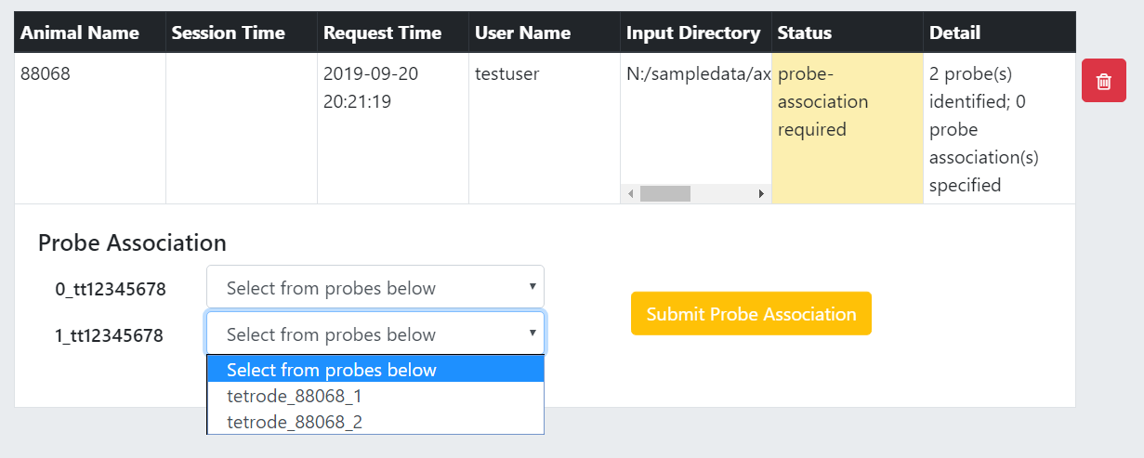
Tetrode Probe Association

Slide 12
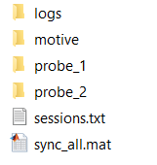
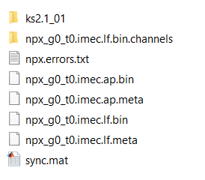
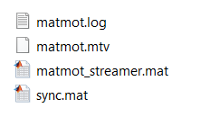
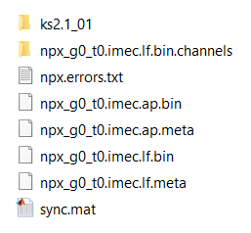
Ingestion of Recording and Tracking - Neuropixels
…/2018-07-03_19-10-39
…/2018-07-03_19-10-39/probe_1
Neuropixels session identified by the .ap.bin files
Multiple recordings – multiple ‘.ap.bin’
Tracking identified by .mtv file
Expect 1 tracking per session
Synchronization info in sync_all.mat
with field syncNet_struct
…/2018-07-03_19-10-39/probe_2
Probe folders (probe_1, probe_2) are associated to the inserted probes via the Session’s Probe Associations
…/2018-07-03_19-10-39/motive

Slide 13
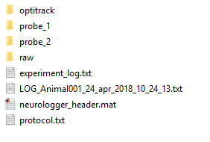
Ingestion of Recording and Tracking - Neurologger
Neurologger session input directory
Neurologger session identified by neurologger_header.mat file
Multiple recordings – multiple header files
neurologger_header.mat
bytesperflashfile: 16777216
recordingtimeperfile_s: 4.0960
nheadstage: 2
headstagetype: 'stacked, with 36-pin millmax'
nchanperdrive: 32
nchan: 64
nsample: 524288
channelmap: [64×1 int32]
fs: 32000
sampletime_sec: 3.1250e-05
filelog: [440×1 double]
ttlpulse: [1800×1 double]
eventtable: [2267×6 table]
nfile: 440
session: [1×1 struct]
Tracking data loaded from the optitrack .csv
Multiple probes identified by:
nheadstage
nchanperdrive
Multiple recordings – identified in the session

Slide 14
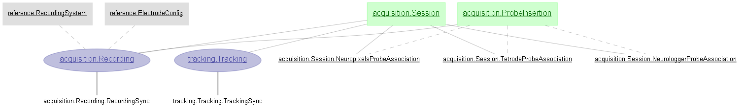
Ingestion of Recording and Tracking
 | Axona | Neuralynx | Neuropixels | Neurologger
 | Search for ‘*.set’ One per recording Probe(s): Identify the tetrode_list by the ‘{}.[0-9]*’ files | Search for ‘.ncs’ files Assume 1 recording per session Probe(s): Identify the tetrode_list by the ‘.ncs’ | Recursive search for ‘.ap.bin’ Probe folder name is the parent folder name Requires ‘sync_all.mat’ to extract time synchronization | Recursive search for ‘neurologger_header.mat’ Recording(s): identified by the number of header.mat found and the number of ‘session’ in ‘header.session’ Probe(s): identified by the ‘header.nheadstage’ Expect ‘probe_1’, ‘probe_2’, … named folders for each probe where the header.mat are found
 | Load from ‘.pos’ file Expect 2D tracking, process with ‘2d_2led’ method to get the Rigid Body position and head angle | Load from ‘.nvt’ file | Expect optitrack type Search for ‘motive’ folder for ‘matmot.mtv’ (one tracking per session) Start-time identified by: meta[‘time_started’] Or recursive search for opticsv Start-time identified by: meta[‘Capture Start Time’] For opticsv, process similar to ‘+Optitrack’ MATLAB package (from Torgeir) to get position, rotation For matmot, process similar to ‘npx_process.m’ (from Rich) to get position, rotation
recording
tracking

Slide 15
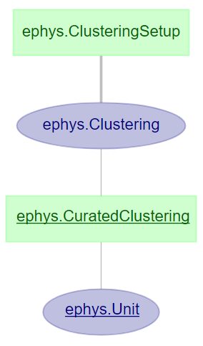
Ingestion of Clustering
Session Group
Time windows
Clustering params
To either trigger a clustering,
or insert a performed clustering requires:
Probe
Output directory
Session grouping and time window(s)
The portion of data to perform clustering on
Data from which inserted probe to perform clustering on
Clustering method and parameters
The directory to output the clustering results to
Notes:
To either trigger a clustering, or insert a performed clustering:

Slide 16
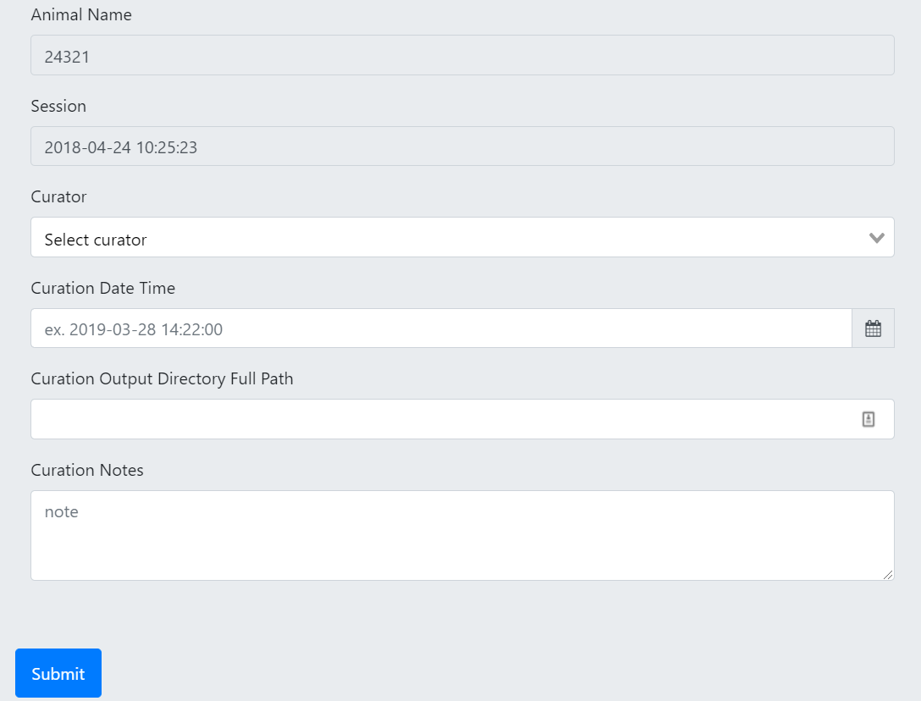
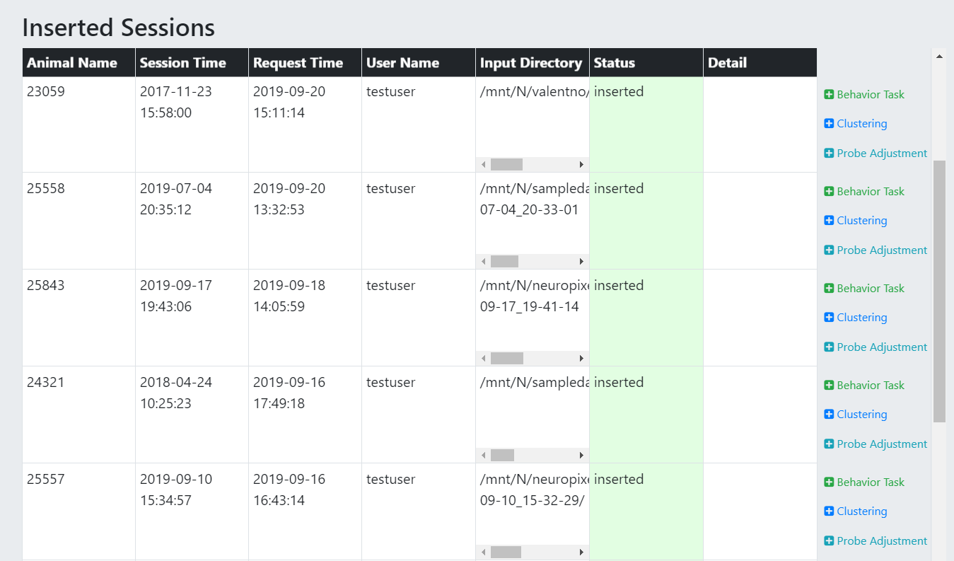
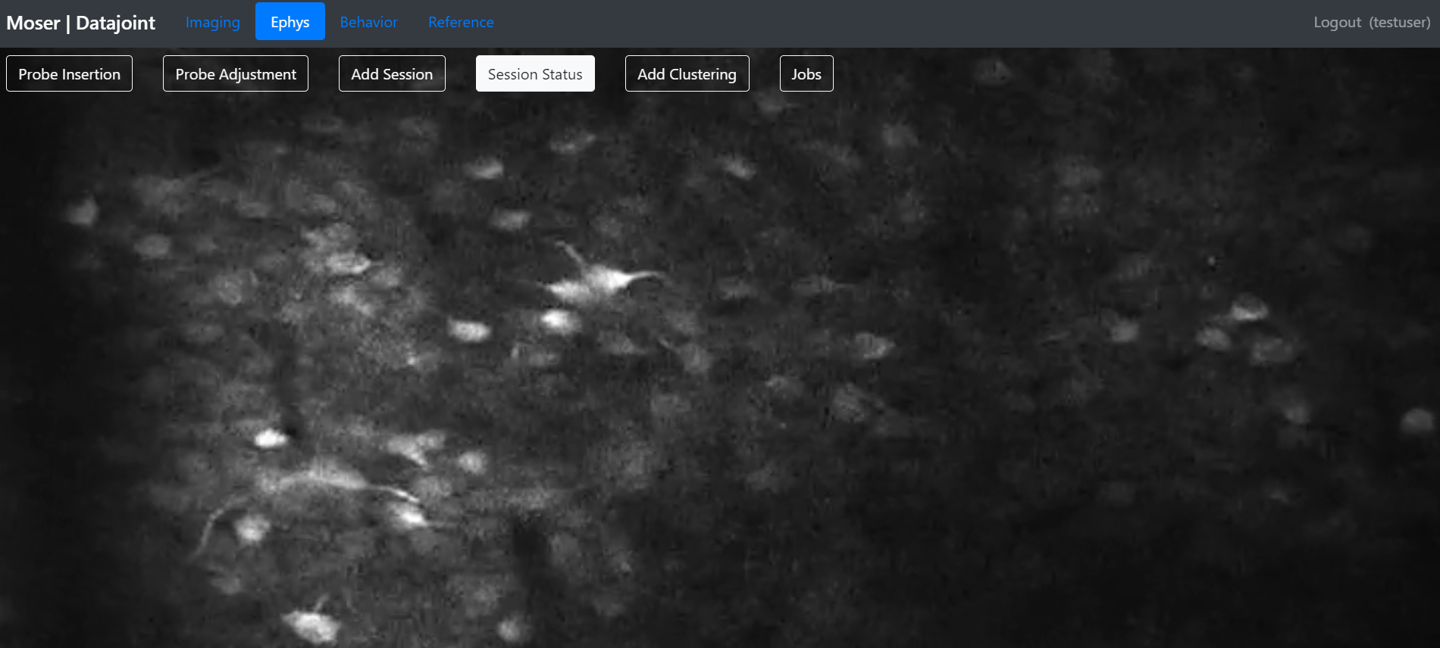
Request curated clustering with Web GUI

Slide 17
A Demo with dj-GUI
A curated clustering request
A multiprobe neuropixels or neurologger
Animal: 24321
/mnt/N/sampledata/deuteron/Torgeir/24321/20180424_01_light

Slide 18
Under the hood
dj-GUI
Session Group
Time windows
Clustering params
Probe
Output directory
Curated Clustering Request
Check input directory
Identify clustering result folder(s), and clustering type
Match clustering folder(s) and probe based on probe-association
Workers

Slide 19
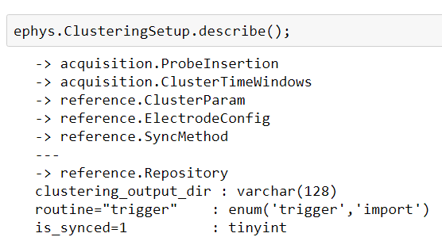
Ingestion of Clustering
…/2018-07-03_19-10-39/probe_1
kilosort
…/2018-07-03_19-10-39
…/2018-07-03_19-10-39/probe_2
kilosort

Slide 20
Ingestion of Clustering – Units, Waveforms, SpikeTimes
KlustaKwik | TINT | MClust | Kilosort
Check for ‘KLUSTA’ folder | Search ‘.cut’ files | Search ‘.t’ files (.t, .t32, .t64) | Recursive search for ‘spike_times.npy’ Identify parent folders Pairing the clustering output for probe_1 with the folder named 'probe_1’ For neuropixels probe, store LFP for every 9th channel For tetrode, store ChannelLFP to the 1st channel on that tetrode
Extract units on each tetrode Based on the tetrode number, assign units to the corresponding probe Assign unit-channel to be the 1st channel on the tetrode that the unit belongs to For ChannelLFP – also assign the tetrode lfp to the 1st channel on that tetrode
Spike times for each unit are extracted, then further segmented per recording (based on recording start/end time), and relativized with respect to the session start (via time difference between session start and recording start) Synchronization is also performed on the extracted spike times, per recording, if needed

